Slide 1
Leveraging Deep Learning for Product Similarit Analysis
Dongguk University
Division of Electronics and Electrical Engineering
Network Intelligence Lab.
Masoumeh Mohammadi Doghozloo

Slide 2
Problem Statement: identifying the most similar products.
1
Exploratory Data Analysis
2
Data Preprocessing
3
Building a Deep Learning Model for Image Processing
4
Computing Embeddings for Images
5
Calculating Similarity between Products
6
Normalization of Similarity Scores
7
Generating Recommendations
8
Visualization of Recommendations

Slide 3
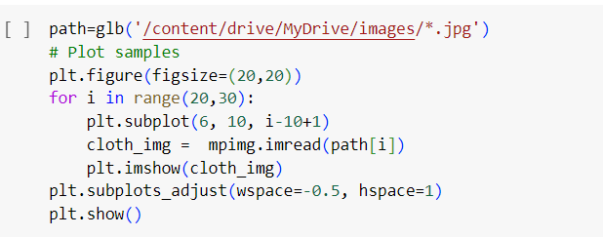
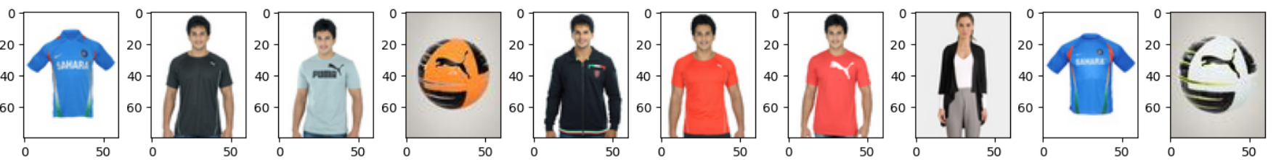
Exploratory Data Analysis
1
Explore the dataset to understand its structure, characteristics, and distributions.
Visualize sample images from the dataset

Slide 4
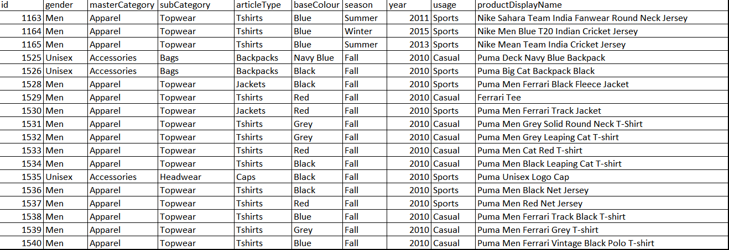
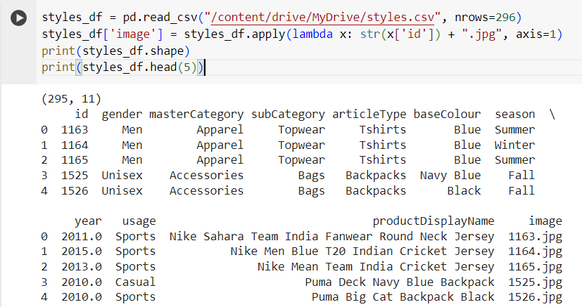
Exploratory Data Analysis

Slide 5
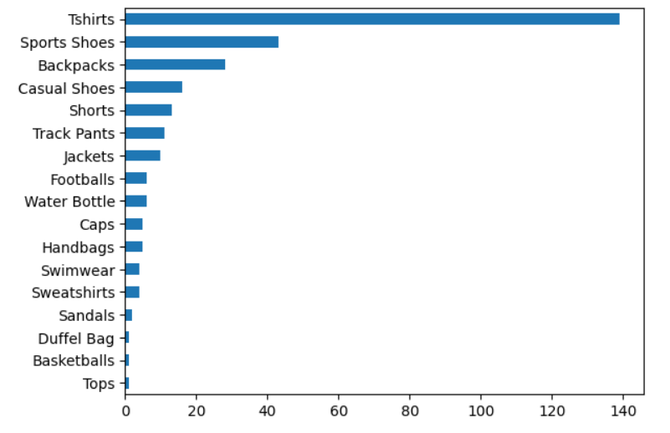
Exploratory Data Analysis
1
Type of products
Number of products

Slide 6

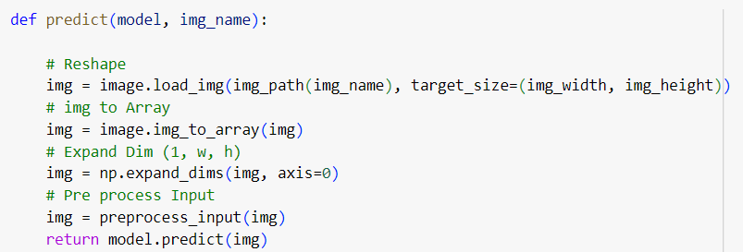
2
Data Preprocessing
Resize images to a standard size and perform any necessary normalization or
augmentation.
Preprocess the dataset to ensure that the images are in a suitable format for input
into the deep learning model.

Slide 7
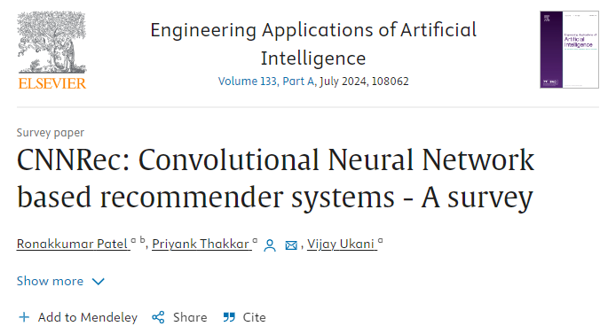
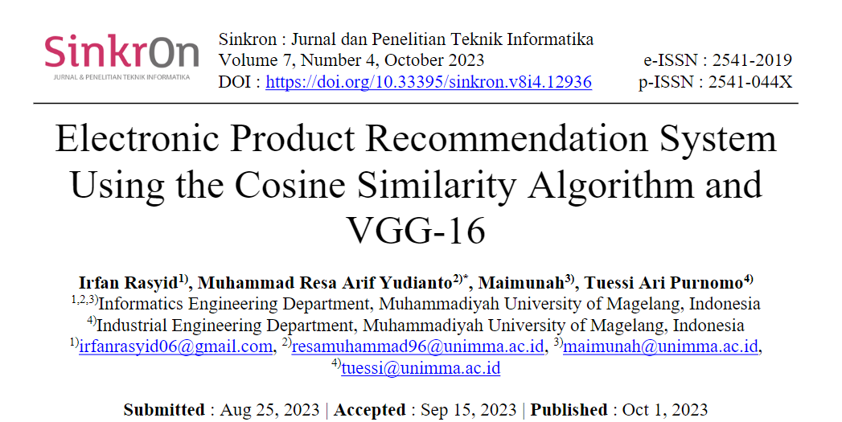
3
Building a Deep Learning Model for Image Processing

Slide 8
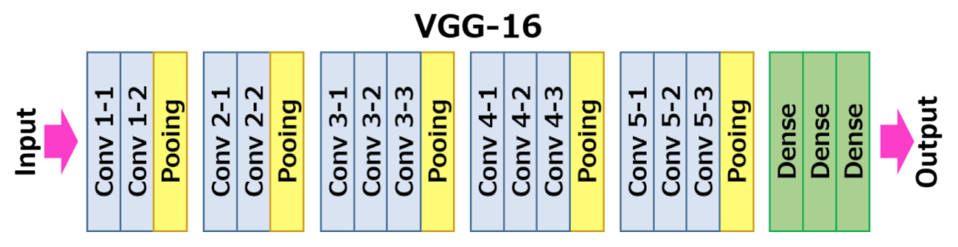
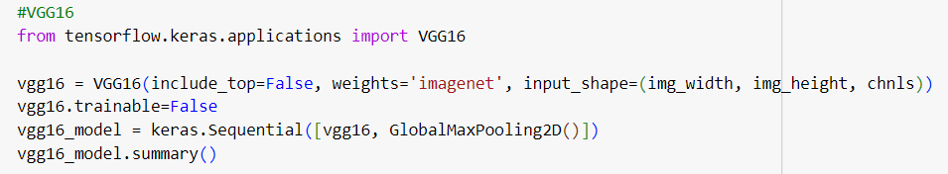
3
Building a Deep Learning Model for Image Processing
GlobalMaxPooling2D()
feature extraction

Slide 9
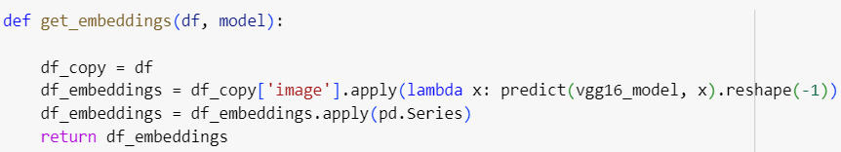

4
Computing Embeddings for Images
An embedding for images is a vector representation of an image in a lower-
dimensional space where similar images are closer together.
Use the trained deep learning model to generate embeddings for each image in
the dataset.
Define functions to preprocess images, make predictions using the deep learning model, and obtain embeddings.

Slide 10


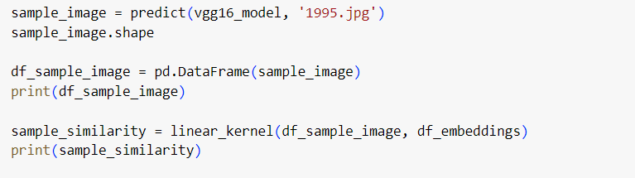
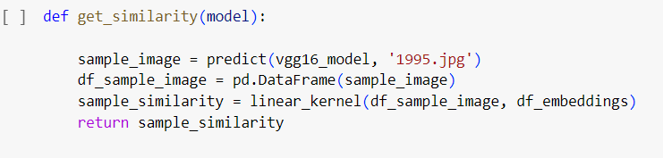
5
Calculating Similarity between Products
sample_image:
1995
Compute the similarity between products based on their embeddings.
Utilize similarity metrics like linear kernel to measure the similarity between embeddings.
linear_kernel:The linear kernel computes the dot product between the vectors, which is a measure of their similarity.

Slide 11
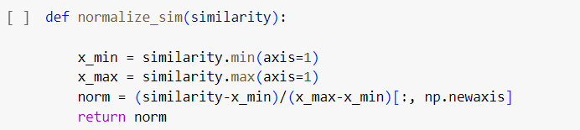
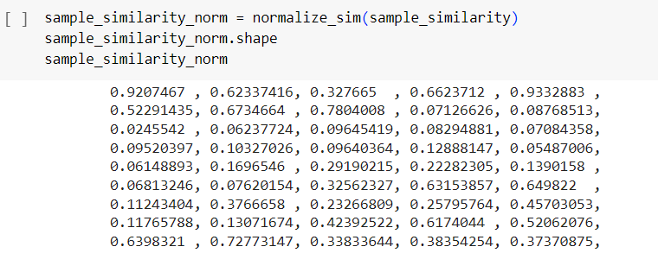
6
Normalization of Similarity Scores
Normalize the similarity scores to ensure that they are on a consistent scale, typically
between 0 and 1.
2. Normalization helps in comparing similarity scores across different pairs of products.

Slide 12
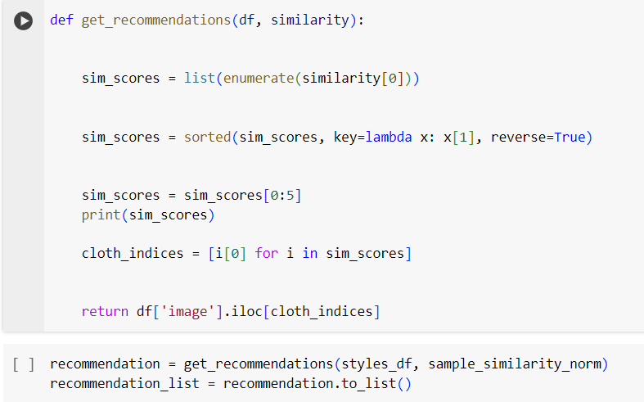
7
Generating Recommendations
Identify the most similar products based on the normalized similarity scores.
Define a function to get recommendations for a given input image by selecting the top similar products from the dataset.

Slide 13
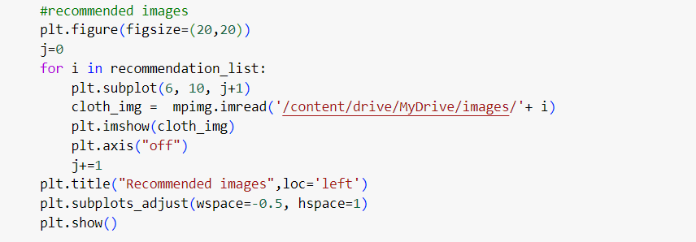
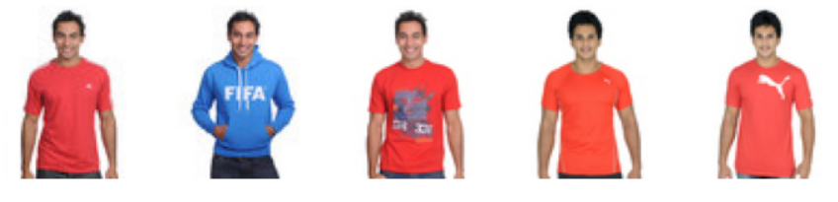
Visualization of Recommendations
8
Visualize the recommended products using matplotlib to provide users with a visual representation of the recommendations.
[(290, 1.0), (219, 0.973908), (127, 0.93346256), (14, 0.9332883), (10, 0.9207467)]

Slide 14
Discussion and Conclusions
The project leverages deep learning techniques, particularly the VGG16 model, to process images of clothing items. Unlike traditional recommendation systems that rely on user
purchase history,
With image processing techniques, we can extract features from products and then identify similar products by comparing these features. This allows us to provide visually appealing
recommendations to users.
Utilize other feature extraction machine learning models, such as Transformers, ResNet, and MobileNet, then compare the results to evaluate their performance.

Slide 15
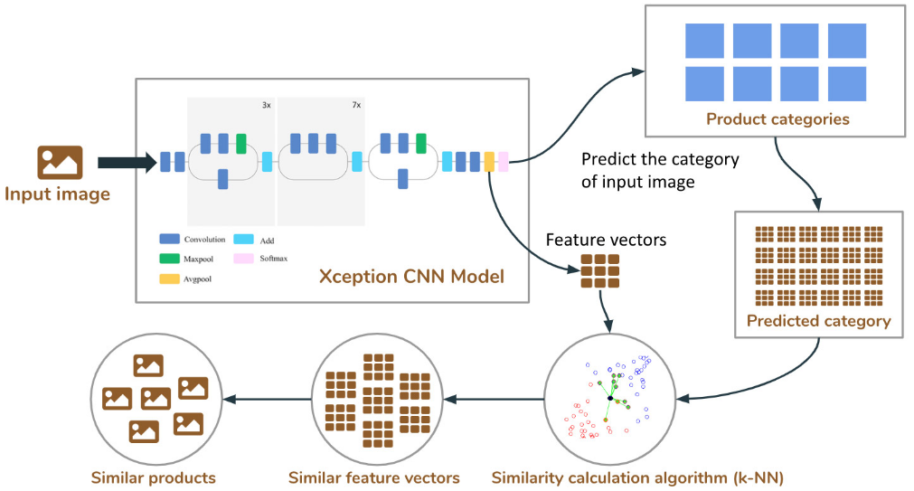
Future project:

Slide 16

Thank you!
Thank you!

